Slide 1

Yoga Pose Detection
Nandini Verma, 01701172020, nandini017btcsai20@igdtuw.ac.in
Simran Singh, 03301172020, simran033btcsai20@igdtuw.ac.in
Sakshi Singh, 07401172020, sakshi074btcsai20@igdtuw.ac.in
Simran, 06501172020, simran065btcsai20@igdtuw.ac.in

Slide 2

Problem Background
The importance of sports, yoga, workout, and exercise in people’s lives is beyond doubt. There are many benefits to doing the exercise. Therefore, it has attracted various researchers to do research related to this area. Yoga is one of the exercises that involve complex situations. Yoga, invented in ancient India, was initially considered an exercise for adults. But because it has many spiritual, physical, and mental benefits, the craze of yoga begin increasing in current ages. Although it comprises of many other elements, it typically emphasizes physical postures. Studies have suggested possible benefits of yoga for several aspects of wellness, including stress management, mental/emotional health, promoting healthy eating/activity habits, sleep, and balance. One of the biggest problems
in Yoga as well as in other exercises people are facing is the correct posture to be performed.

Slide 3
Motivation
Yoga’s popularity is increasing daily. Doing Yoga regularly helps physically, mentally, and spiritually. Many people practice yoga without any formal training. However, practicing yoga incorrectly or even without proper supervision can lead to serious health problems such as stroke, nerve damage, and so on. It’s not easy for novice people to find the incorrect parts of their Yoga poses by themselves and not every user has the opportunity to work with a professional educator. For many yoga beginners, self-study, including such as blindly following a recorded yoga video or remotely following a live yoga session, has been the only way to master the fundamentals. As a result, they have no way of determining whether their position is perfect or not without the instructor’s assistance. Therefore there is a need for scientific posture analysis ensuring appropriate yoga posture is an essential aspect to consider.

Slide 4
The most crucial part of yoga practice is to do it correctly, as any incorrect position can be harmful and lead to injury.
Self-Learning Assistant needs to support the self-learners in receiving feedbacks for correct experiences and exercises. It is very important that learning from the self-learning system should give the same feeling and experience to that of learning from the professional instructors. Moreover, it should make the self-learners more understandable and flexible. It should also attract self-learners in order to continue using the system.
The feedback function should give instructions to the self-learner, by recording the performance and estimating how much the learner can follow the instructions from the instructor and which parts are incorrect through similarity measurements.
This will help the learners to know their weak parts and be able to retry the wrong parts. That is the best way to let the self-learners understand and get the advantages of doing the correct one.

Slide 5

Problem Statement
Estimating the Yoga pose from input image using DL.

Slide 6
Related Work
Shruti Kothari 2020 Yoga Pose Classification Using Deep Learning Ph.D. thesis SAN JOSE STATE UNIVERSITY
A computational method using deep learning, particularly CNN, for classifying the Yoga postures from images. A dataset containing 1000 images was used , which distributed over 6 classes for building the classification model. Nearly 85% accuracy was obtained for this work.
Chen H T, He Y Z, Chou C L, Lee S Y, Lin B S P and Yu J Y 2013 Electronic Proceedings of the 2013 IEEE International Conference on Multimedia and Expo Workshops, ICMEW 2013
A yoga posture recognition system that can recognize the yoga posture performed by the trainer. In the first step, kinetic was used to capture the body map of the user and body contour extraction. Then, the star skeleton which is a fast skeletonization technique by connecting from the centroid to other joint parts is done as the next step. From this technique, accuracy of 96% is acquired.

Slide 7
Trejo E W and Yuan P 2018 2018 2nd International Conference on Robotics and Automation Sciences, ICRAS 2018 12–17
A model for pose correction in yoga. the user will receive real-time instruction about the pose correction made by an expert. for this, a recognition algorithm based on the AdaBoost algorithm was used to create a robust database for estimating 6 yoga poses. Finally, 92% accuracy is obtained.

Slide 8
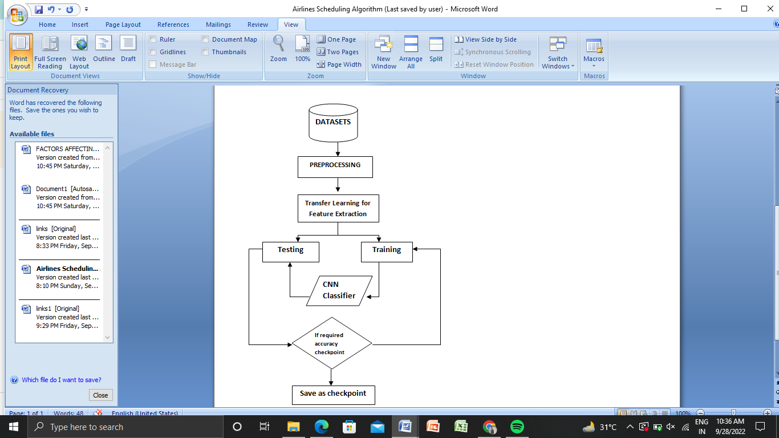
Base Paper
Yoga Asana Identification: A Deep Learning Approach
Josvin Jose and S Shailesh 2021 IOP Conf. Ser.: Mater. Sci. Eng. 1110 012002
Architecture of Yoga Asana Classifier

Slide 9
DataSet
Yoga-82 dataset
LINK: https://drive.google.com/drive/folders/1JsR99y8kGr5aPeBB4LJvvo1m6oqQdeEU?usp=sharing
There are a total of 82 yoga pose classes in the dataset.
The dataset has a varying number of images in each class from 64 (min.) to 1133 (max.) with an average of 347 images per class.
Form Link: https://docs.google.com/forms/d/e/1FAIpQLSdXAv4qZusE4O9aVvWJgCOJZtLxIur4PhxgV8GSufPioLI0ng/viewform
Drive link:
https://drive.google.com/file/d/1cQHhT7Qg4RsrVUJq9CoBBfCGNedD2zhs/view?usp=sharing

Slide 10
Milestone 1

Slide 11
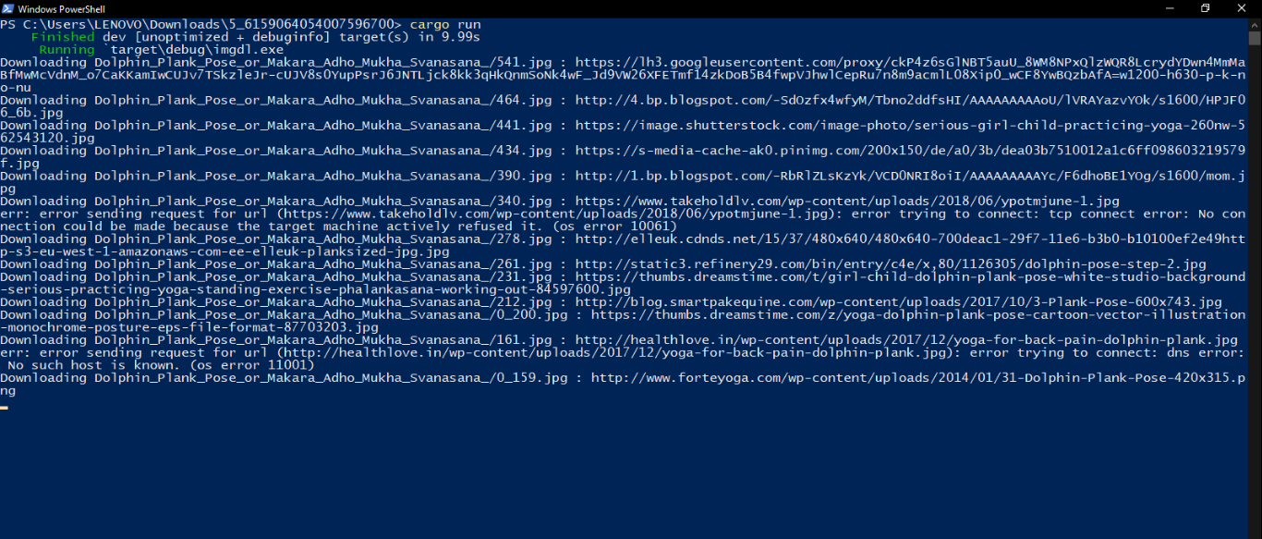
Data was extracted using RUST API
Command- cargo run

Slide 12
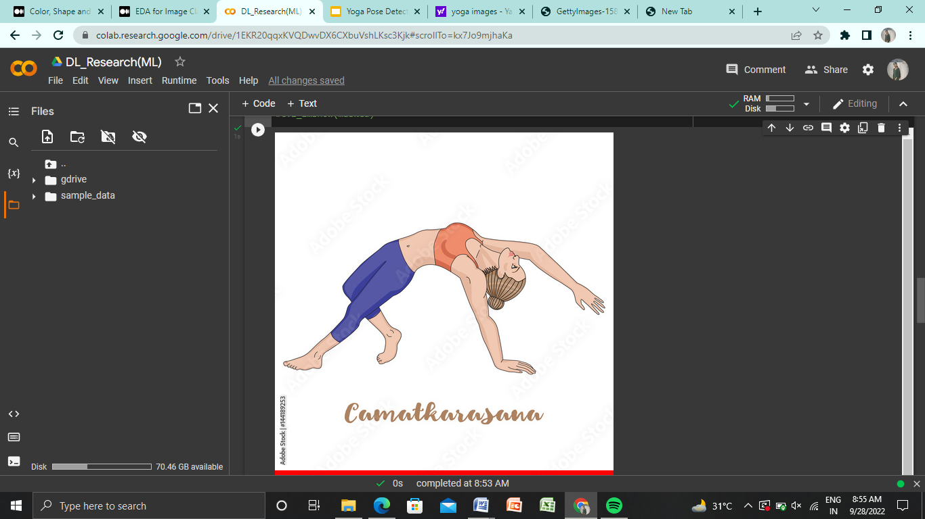
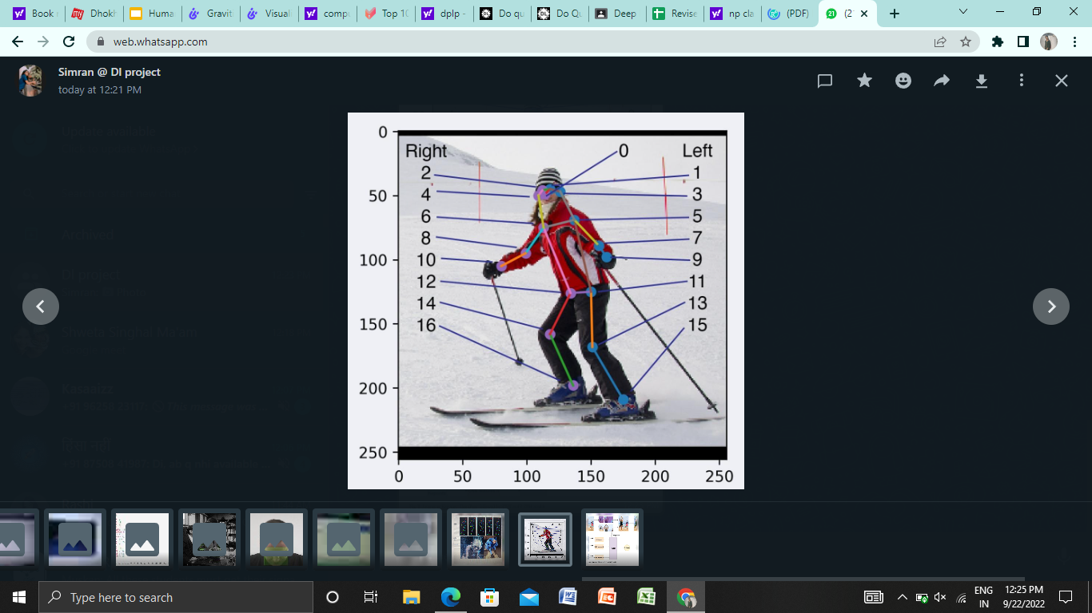
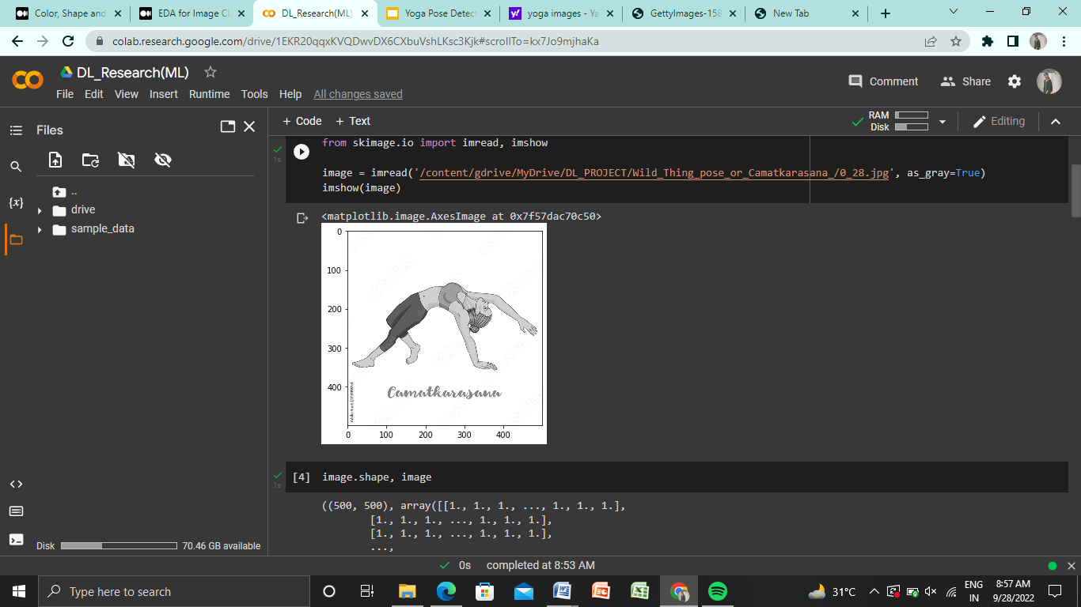
Data Exploration / Visualization
Data Visualization link : https://colab.research.google.com/drive/1EKR20qqxKVQDwvDX6CXbuVshLKsc3Kjk?usp=sharing

Slide 13
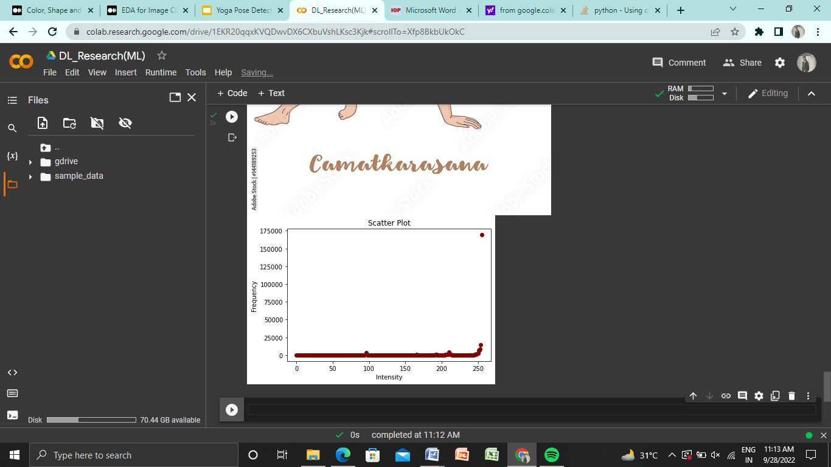
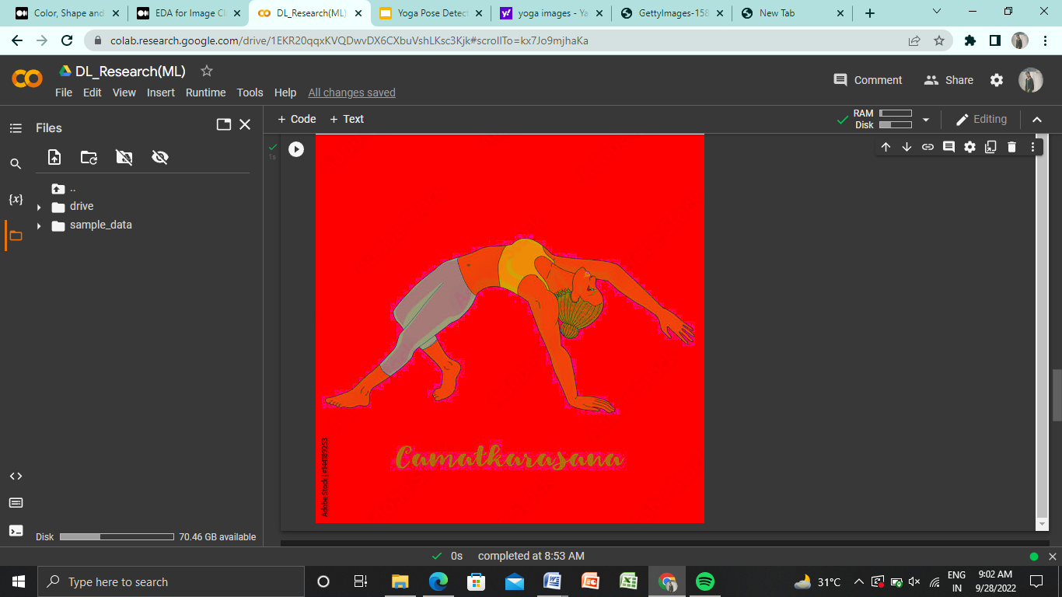

Slide 14
Milestone 2

Slide 15
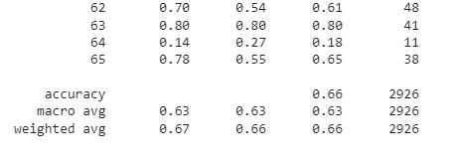
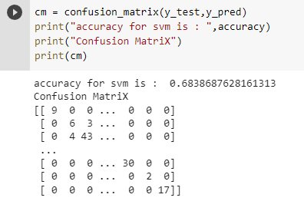
Machine Learning Implementations
K Nearest Neighbour : The k-nearest neighbors algorithm, also known as KNN or k-NN, is a non-parametric, supervised learning classifier, which uses proximity to make classifications or predictions about the grouping of an individual data point.

Slide 16
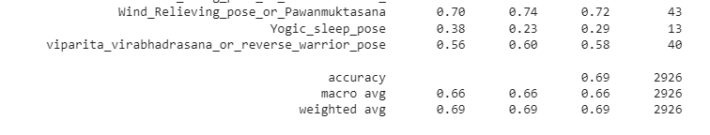
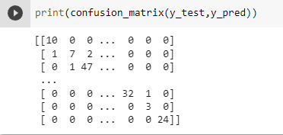
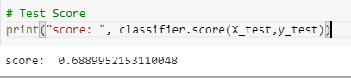
Logistic Regression : Logistic regression estimates the probability of an event occurring, such as voted or didn’t vote, based on a given dataset of independent variables.

Slide 17
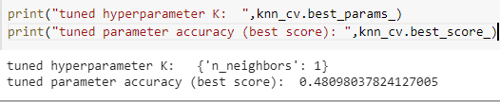
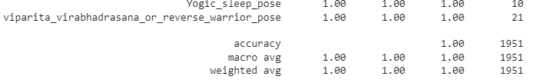
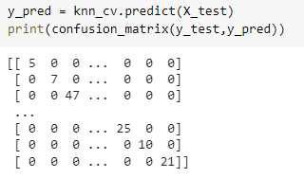
K-Nearest Neighbours with Cross Validation : k-Nearest Neighbors (kNN) is often used for machine learning. You can choose the value for topK based on your experience, or using cross-validation to optimize the hyperparameters.

Slide 18
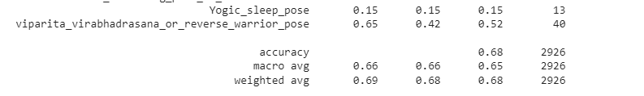
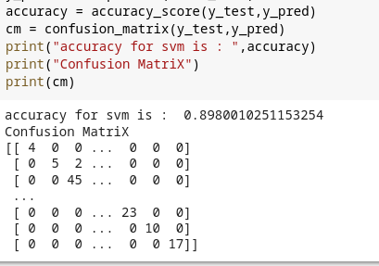
Support Vector Classification : Support Vector Machine is a supervised classification algorithm where we draw a line between two different categories to differentiate between them. SVM is also known as the support vector network.

Slide 19
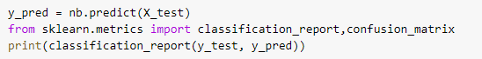
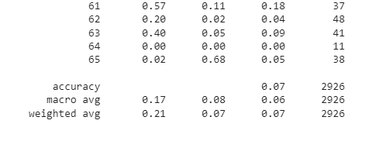
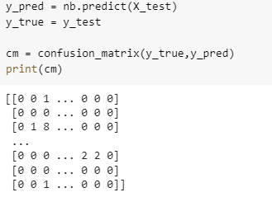
Gaussian Naive Bayes : Naive Bayes are a group of supervised machine learning classification algorithms based on the Bayes theorem. It is a simple classification technique, but has high functionality. They find use when the dimensionality of the inputs is high. Complex classification problems can also be implemented by using Naive Bayes Classifier.

Slide 20
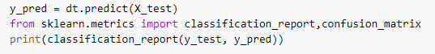
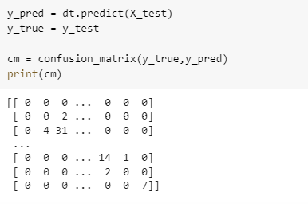
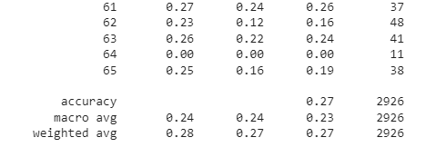
Decision Tree : A decision tree is a non-parametric supervised learning algorithm, which is utilized for both classification and regression tasks. It has a hierarchical, tree structure, which consists of a root node, branches, internal nodes and leaf nodes.

Slide 21
B) Deep Learning Implementations
CNN Model is used to classify Yoga images.
convolutional base is defined using a common pattern: a stack of Conv2D and MaxPooling2D layers.
The 3D output is flattened (or unroll) to 1D, then one or more Dense layers are added on top.
https://colab.research.google.com/drive/1Tqfu_t94Q0qs789marCMGVUCG6FRMbOs#scrollTo=vj0D-oRvZjXT

Slide 22
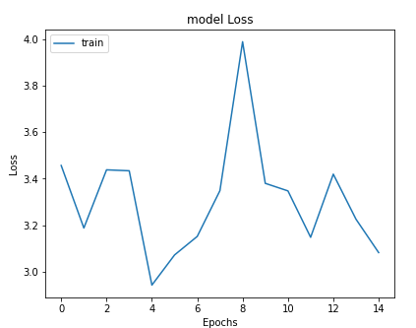
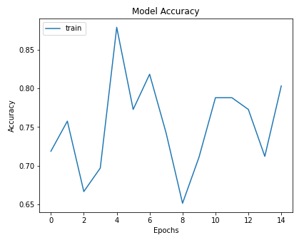

Slide 23
Milestone 3

Slide 24
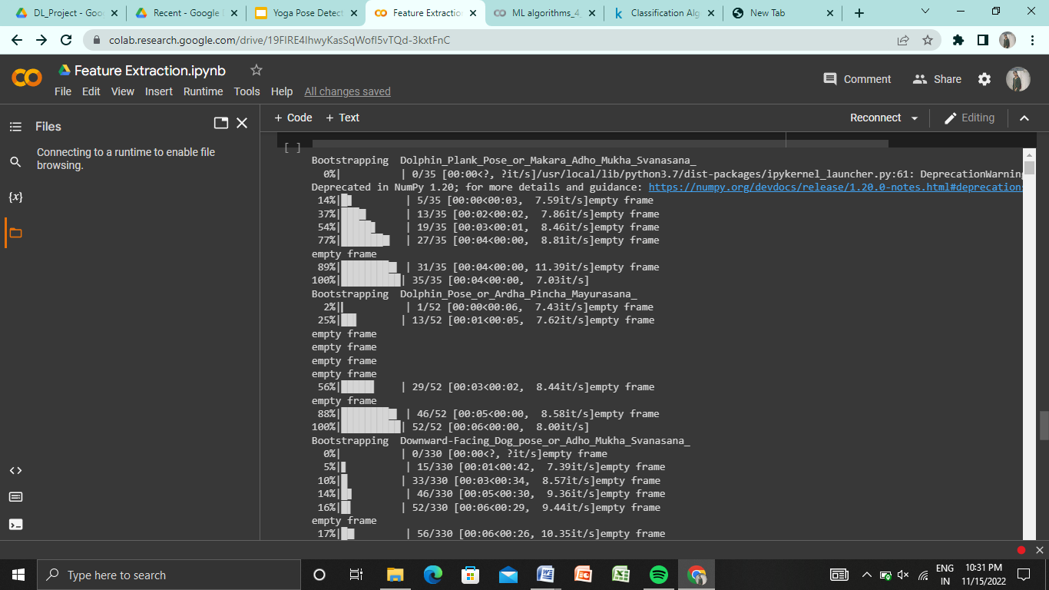
Feature Extraction
Feature Extraction is a process in which we find the 17 pairs of keypoints of a human body for different poses.
We have x,y,z coordinates for each and every keypoints.

Slide 25
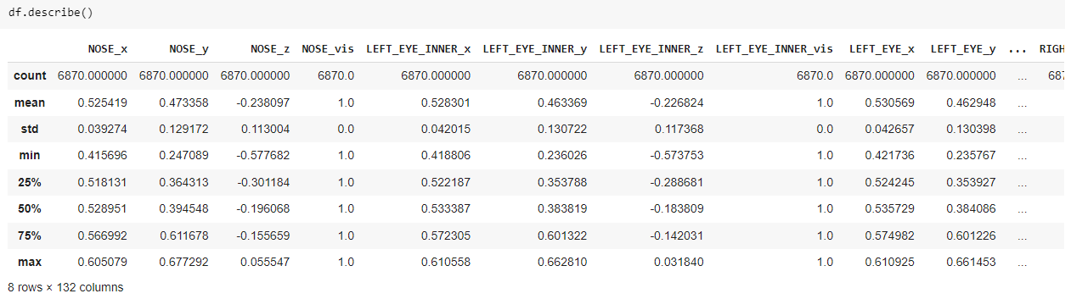

Slide 26
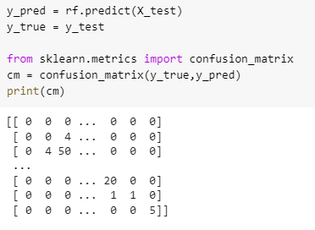
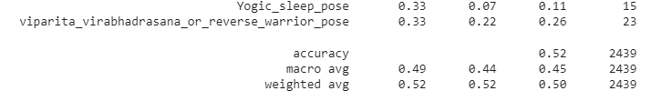
Ensemble Techniques
Random Forest : Random forest is a commonly-used machine learning algorithm trademarked by Leo Breiman and Adele Cutler, which combines the output of multiple decision trees to reach a single result. Its ease of use and flexibility have fueled its adoption, as it handles both classification and regression problems.

Slide 27
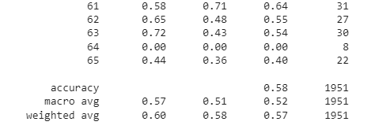
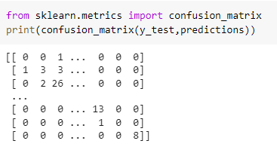
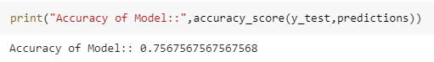
2. XG Boost : XGBoost is an optimized distributed gradient boosting library designed to be highly efficient, flexible and portable. It implements Machine Learning algorithms under the Gradient Boosting framework. It provides a parallel tree boosting to solve many data science problems in a fast and accurate way.

Slide 28
Report Link
https://www.overleaf.com/read/jhjmjnwgmzcn

Slide 29
Comparison between the accuracy of our model and the base paper
Models | CNN
Our accuracy | 90%
Base paper accuracy | 82%

Slide 30
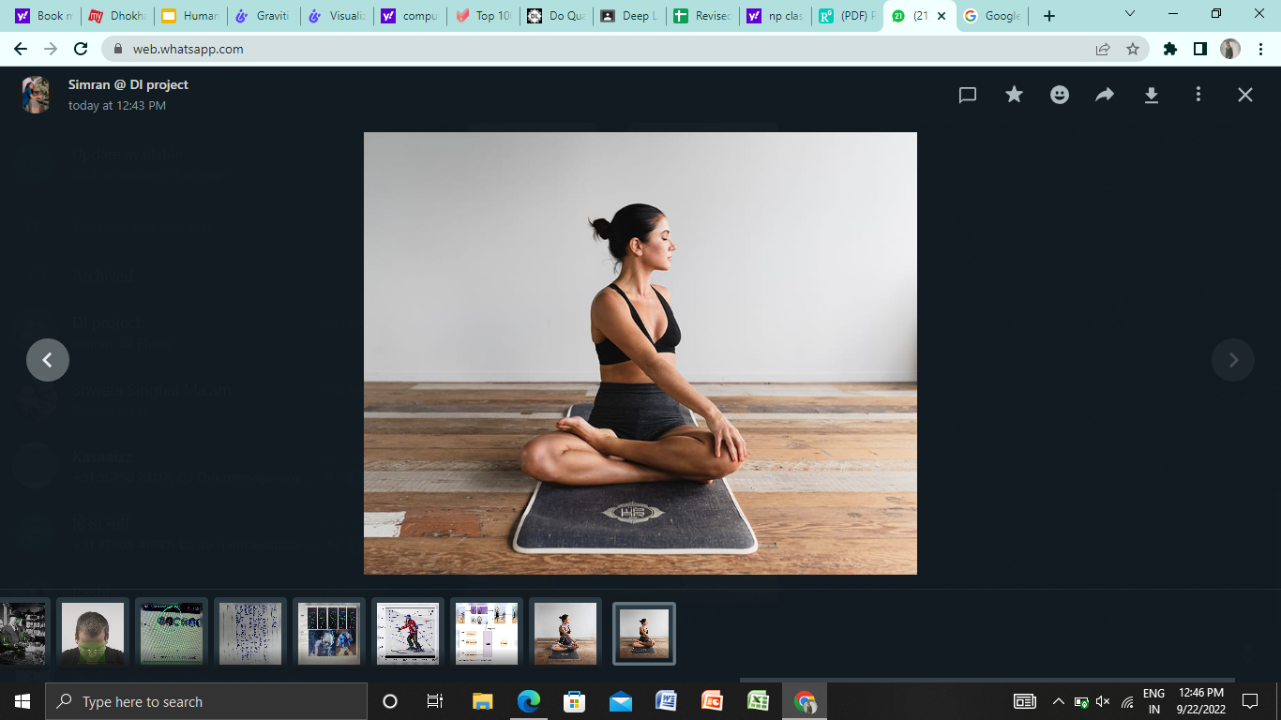
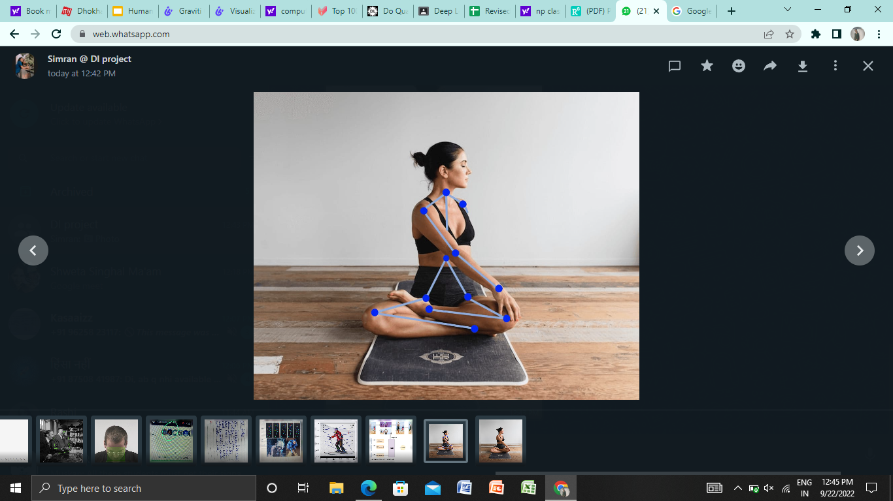
Future Scope
Trying to apply this model on automated Yoga Trainers

Slide 31
Contribution
Simran(065):
Contribute to search dataset
EDA
ML Algorithms
Feature Extraction
Presentation
Simran Singh(033):
Contribute to search dataset
Extract the dataset(images) from url using RUST
CNN
Ensemble Technique
Sakshi Singh(074):
Search Research Paper
Report and Presentation
ML Algorithms
Ensemble Technique
Nandini Verma(017):
Search Base Paper
Ensemble Technique
CNN

Slide 32
Thank You!

